Slide 1
Dummy Data Report
A report that we've made for some purpose (all of this data etc. is artificial)
The date this report was produced was: 27/07/2022

Slide 2
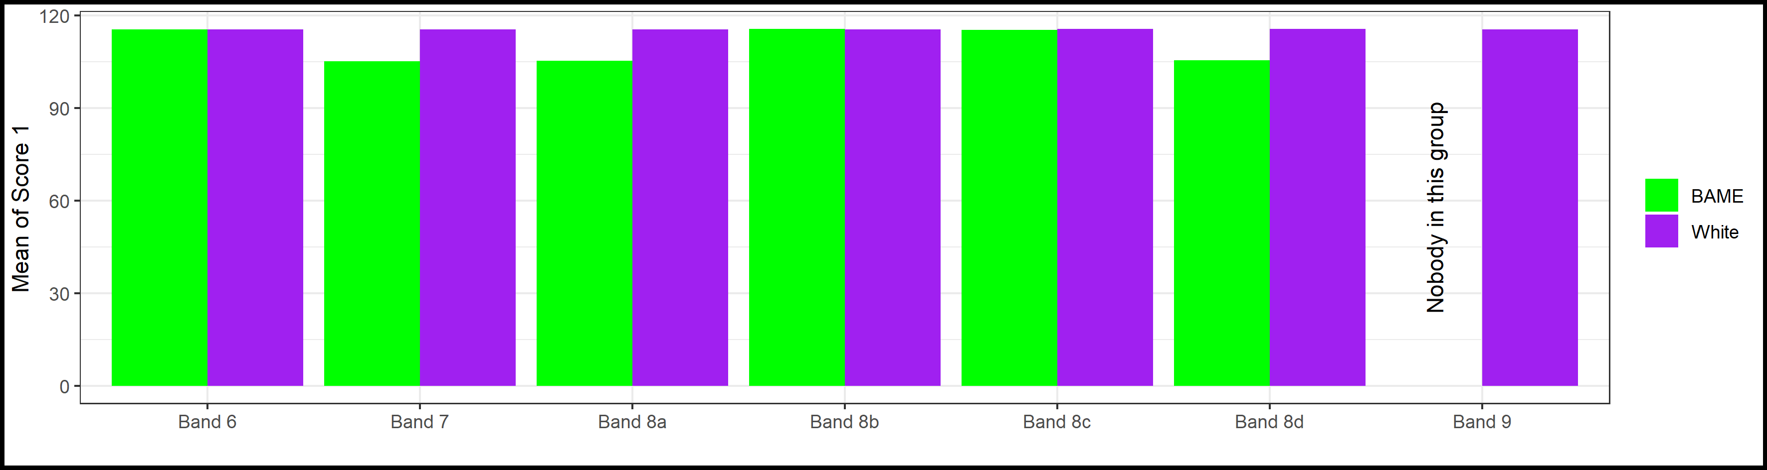
Fascinating content on Slide 2
Table 1: Dummy demographic data by dummy payband
AfC Pay Band | Males | Females | BAME | White | Total
Band 6 | 3 | 3 | 3 | 3 | 6
Band 7 | 6 | 3 | 1 | 8 | 9
Band 8a | 11 | 7 | 1 | 17 | 18
Band 8b | 12 | 15 | 7 | 20 | 27
Band 8c | 13 | 12 | 4 | 21 | 25
Band 8d | 4 | 3 | 3 | 4 | 7
Band 9 | 7 | 1 | 0 | 8 | 8
Plot 1: Dummy scores by dummy payband and ethnicity

Slide 3
Horrifying content on Slide 3
Table 2: Dummy scores. I'd change the style (including column widths) here if I were you (you need to look at 'table2_powerpoint' in the script 'format_tables-powerpoint.R')
AfC Pay Band | Ethnicity | Score 1 | Score 2 | Flag 1 | Head Count
Band 6 | BAME | 115.5092 | 5.272727 | 0.07575758 | 66
Band 6 | White | 115.4084 | 4.818182 | 0.06060606 | 66
Band 7 | BAME | 105.1767 | 5.045455 | 0.04545455 | 22
Band 7 | White | 115.4391 | 4.829545 | 0.06818182 | 176
Band 8a | BAME | 105.2388 | 5.863636 | 0.04545455 | 22
Band 8a | White | 115.4251 | 4.898396 | 0.06417112 | 374
Band 8b | BAME | 115.5705 | 5.051948 | 0.04545455 | 154
Band 8b | White | 115.4334 | 5.056818 | 0.05000000 | 440
Band 8c | BAME | 115.3501 | 4.693182 | 0.02272727 | 88
Band 8c | White | 115.5235 | 4.961039 | 0.03679654 | 462
Band 8d | BAME | 105.4863 | 5.181818 | 0.06060606 | 66
Band 8d | White | 115.5560 | 4.772727 | 0.03409091 | 88
Band 9 | White | 115.4631 | 4.886364 | 0.04545455 | 176

Slide 4
Boring content on Slide 4
Some text which rambles on and on and on, who knows when it will ever stop, is there anything interesting being said here? I don't think so, blah, blah, blah, blah, blah, blah, blah, blah, blah, blah, blah, blah, blah, blah, blah, blah, blah, blah, blah, blah, blah, blah, blah, blah, blah, blah, blah, blah, blah, blah, blah, blah, blah, blah, blah, blah, blah, blah, blah, blah, blah, blah, blah, blah, blah, blah, blah, blah, blah, blah, blah, blah, blah, blah, blah, blah, blah, blah, blah, blah, blah, blah, blah, blah, blah, blah, blah, blah, blah, blah, blah, blah, blah, blah, blah, blah, blah, blah, blah, blah, blah, blah, blah, blah, blah, blah, blah, blah, blah, blah, blah, blah, blah, blah, blah, blah, blah, blah, blah, blah, blah, blah, blah, blah, blah, blah, blah, blah, blah, blah, blah, blah, blah, blah, blah, blah, blah, blah, blah, blah, blah, blah, blah, blah, blah, blah, blah, blah, blah, blah, blah, blah, blah, blah, blah, blah, blah, blah, blah, blah, blah, blah, blah, blah, blah, blah, blah, blah, blah, blah, blah, blah, blah, blah, blah, blah, blah, blah, blah, blah, blah, blah, blah, blah, blah, blah, blah, blah, blah, blah, blah, blah, blah, blah, blah, blah, blah, blah, blah, blah, blah, blah, blah, blah, blah, blah, blah, blah, blah, blah, blah, blah, blah, blah, blah, blah, blah, blah, blah, blah, blah, blah, blah, blah, blah, blah, blah, blah, blah, blah, blah, blah, blah, blah, blah, blah, blah, blah, blah, blah, blah, blah, blah, blah, blah, blah, blah, blah, blah, blah, blah, blah, blah, blah, blah, blah, blah, blah, blah, blah, blah, blah, blah, blah, blah, blah, blah, blah, blah, blah, blah, blah, blah, blah, blah, blah, blah, blah, blah, blah, blah, blah, blah, blah, blah, blah, blah, blah, blah, blah, blah, blah, blah, blah, blah, blah, blah, blah, blah, blah, blah, blah, blah, blah, blah, blah, blah, blah, blah, blah, blah, blah, blah, blah, blah, blah, blah, blah, blah, blah, blah, blah, blah, blah, blah, blah, blah, blah, blah, blah, blah, blah, blah, blah, blah, blah, blah, blah, blah, blah, blah, blah, blah, blah, blah, blah, blah, blah, blah, blah, blah, blah, blah, blah, blah, blah, blah, blah, blah, blah, blah, blah, blah, blah, blah, blah, blah, blah, blah, blah, blah, blah, blah, blah, blah, blah, blah, blah, blah, blah, blah, blah, blah, blah, blah, blah, blah, blah, blah, blah, blah, blah, blah, blah, blah, blah, blah, blah, blah, blah, blah, blah, blah, blah, blah, blah, blah, blah, blah, blah, blah, blah, blah, blah, blah, blah, blah, blah, blah, blah, blah, blah, blah, blah, blah, blah, blah, blah, blah, blah, blah, blah, blah, blah, blah, blah, blah, blah, blah, blah, blah, blah, blah, blah, blah, blah, blah, blah, blah, blah, blah, blah, blah, blah, blah, blah, blah, blah, blah, blah, blah, blah, blah, blah, blah, blah, blah, blah, blah, blah, blah, blah, blah, blah, blah, blah, blah, blah, blah, blah, blah, blah, blah, blah, blah, blah, blah, blah, blah, blah, blah, blah, blah, blah, blah, blah, blah, blah, blah, blah, blah, blah, blah, blah, blah, blah, blah, blah, blah, blah, blah, blah, blah, blah, blah, blah, blah, blah, blah, blah, blah, blah, blah, blah, blah, blah, blah, blah, blah, blah, blah, blah, blah, blah, blah, blah, blah, blah, blah, blah, blah, blah, blah, blah, blah, blah, blah, blah, blah, blah, blah, blah, blah, blah, blah, blah, blah, blah, blah, blah, blah, blah, blah, blah, blah, blah, blah, blah, blah, blah, blah, blah, blah, blah, blah, ...

Slide 5
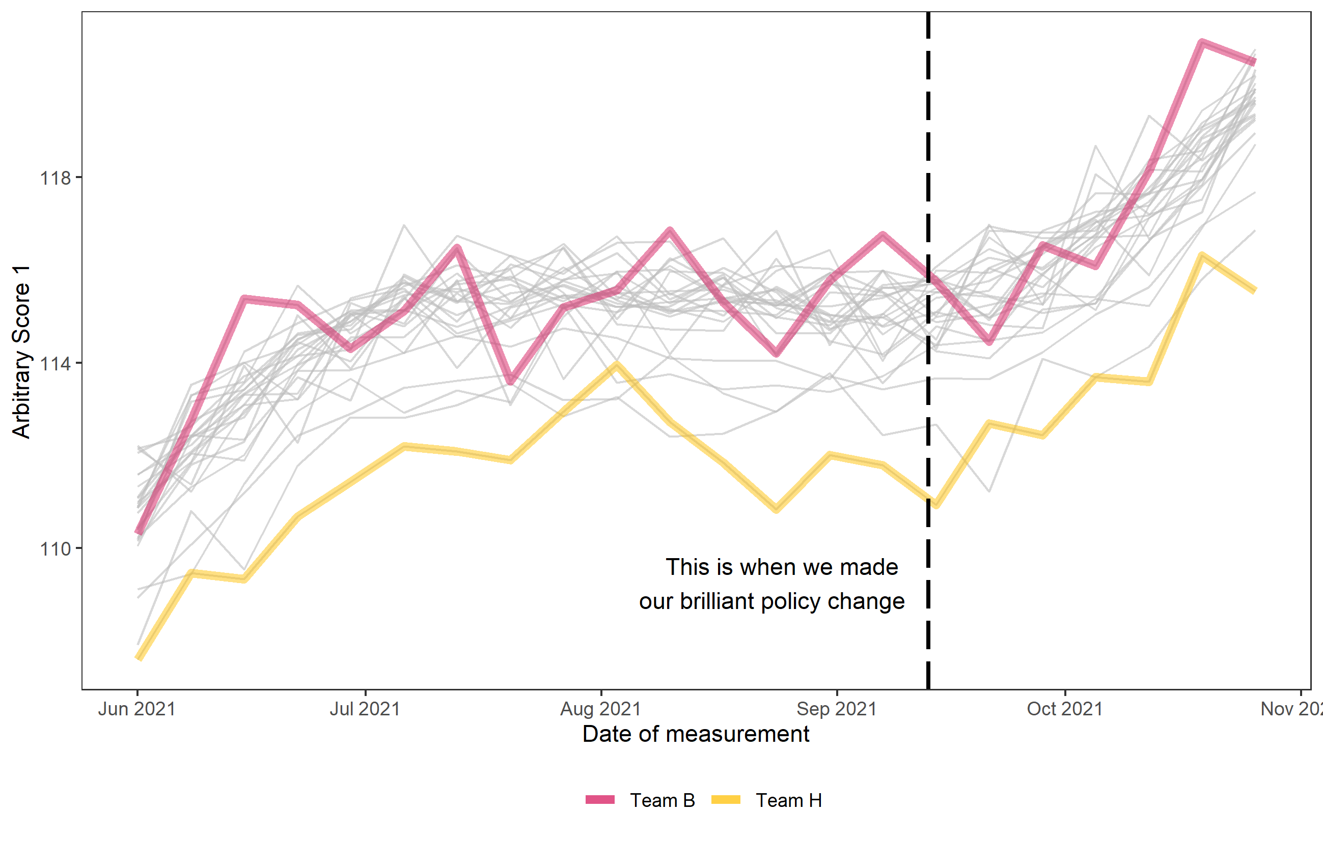
Jazzy plot on Slide 5
This box is just a placeholder for now - but it's where somebody is going to type in their great insights about this plot before circulating the slide deck.
Plot 2: Mean dummy scores by team time series. Each grey line is a team. Teams B and H highlighted.

